Slide 1
Digital Graphics
By Hayyan

Slide 2
Analysing a Graphic
There are lots of different types of graphics. These include:
Posters
Web images
Film Covers
Adverts
Logos
Magazines

Slide 3
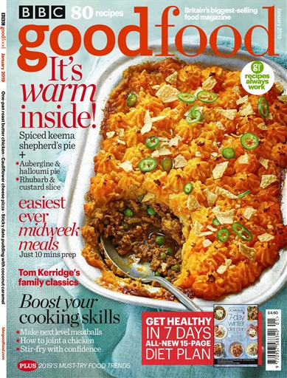
Magazines
This magazine is a bitmap image as the pixels are visible when you zoom it in. It has a dpi of 96 which means it is not yet suitable for printing as you need to have a dpi of 300+ (Will need to maybe edit in Photoshop). Magazines need to be high quality as people will read it, so it needs to be clear. The pixel dimensions are 389x512.
Purpose of a magazine
The purpose of a magazine is to share with the reader about their products and engaging the reader to buy them by also entertaining them with other things.
Magazines are best suited for print because when you publish them, lots of people are going to read it. This magazine has a colour theme of red, orange, white, green and black. The text also includes these colours and it is in a basic font, so it is seen clearly.
The effect the colours will have on the audience is that they will want to buy it as the colours are vibrant and it is eye-catching. Shepherd’s Pie is a famous dish so will attract the target audience.

Slide 4

Logos
The purpose of a logo is to inform people of your company and how to find it. It is used by companies and it is usually a symbol so people can remember it and associate it with the company.
This particular logo just has black in it. This is so people can see it clearly and it is easy to remember which is why everyone recognizes it. In addition, it has a basic font for the same reason as above.
This logo is good quality as it looks really clear. This is lossless compression as the picture does not lose quality when you zoom in/out.
This image has a dpi of 72 so it is currently not suitable for printing as it needs to be 300+ dpi so it is best suited for screen. This image is a vector image because when you zoom it in, there are no pixels visible. Also, logos tend to use vector type images so people can see it clearly.
The pixel dimensions are 500x501.

Slide 5

DVD Covers
The purpose of a film cover is to attract people’s attention and make it eye-catching so people will want to watch the movie.
This image is currently a bitmap as the pixels are visible when zoomed in. This film cover has dark colour such as black which is associated with darkness, so it is suggested that it is a horror film, it also has someone trying to escape from being pulled which builds suspense.
The dpi for a film cover needs to be higher than 300 because people need to be able to see what it is about so they can buy it. It also needs to be high quality so it can be printed and sold to people.
The effect it will have on the target audience (horror lovers) is that they will want to buy it as it looks eye-catching and they will be interested to find out what is “under the bed” and how this all started.
The pixel dimensions are 288x409.

Slide 6
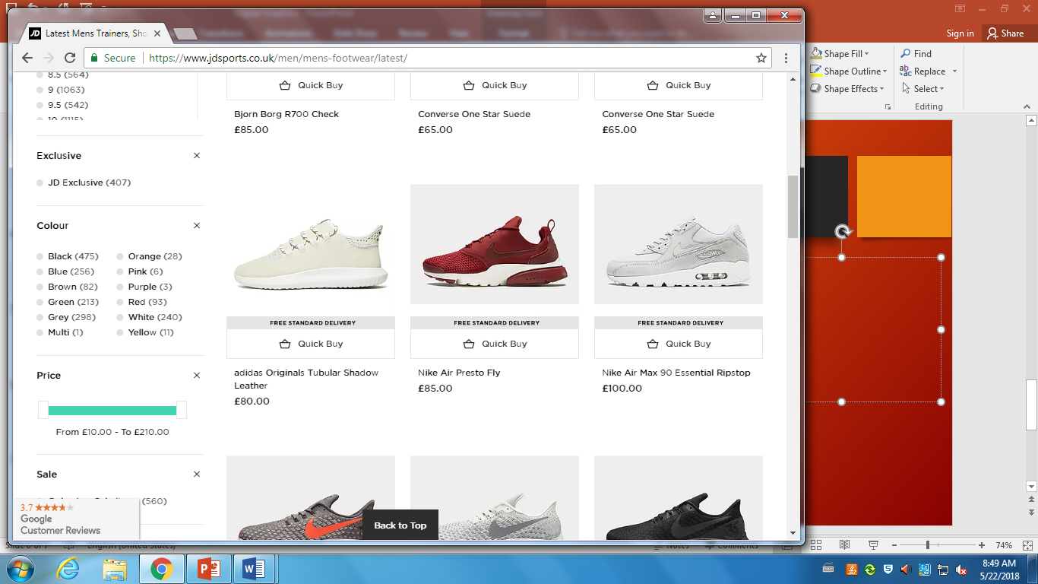
Web Images
The purpose of web images is to attract the readers attention by advertising a product so they will be interested in buying it if it looks good. Shopping websites like JD Sports and Argos tend to use web images.
This particular web image is showing a shoe for sale. As you can see, it is not of high quality as it is only small. Customers will want to buy it because the web image is a preview of the shoe so you don’t need to go to the store just to take a look at it.
The dpi for web images will be around 72dpi. This is because they don’t need to be of high quality as they appear quite small on the actual website so there is no need. The pixel dimensions are 470x609.
The effect it will have on the audience is that whenever they want to buy something, e.g. a backpack, they will want to see previews so they can see which suits them the best.

Slide 7

Posters
The purpose of posters is to inform people of a certain event happening by making it eye-catching. Posters can also be used for many things.
This specific poster is showing that there is a mega sale up to 40% off items in a particular store. This makes it eye-catching because customers like sales so they can save money. Also, there are vibrant colours so it looks good and colourful.
Posters need to have a dpi of 300+ because they are specially for printing as you give posters to many people so they all know about the event that is taking place. It also needs to be high quality so people can see what is happening.
The effect it will have on the audience is they will want to know more about the event so if it is eye-catching then they will want to read it.
The pixel dimensions are 217x281.

Slide 8
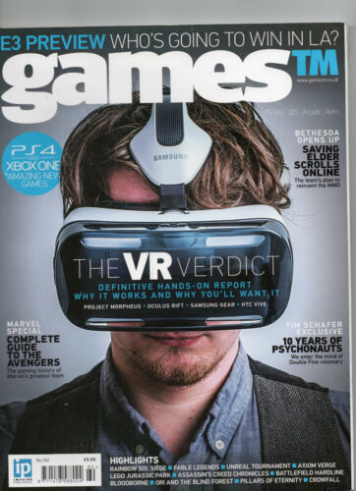
Gaming magazine
The purpose of a gaming magazine is to attract the target audience to the magazine so they will want to buy it. Also, they tend to put a newly released game or item at the front cover, so it further attracts the audience to try it out.
The target audience for this particular gaming magazine is late teens and adults (17+) who have an interest in VR and is not really suitable for below as it can affect young children mentally.
The effect that this layout would have is that the target audience will stop and will want to look at more information regarding VR such as games that now support it and updates. People that are interested in something will be eager to check out new things regarding it.
This is lossless compression as it doesn’t lose quality when you zoom in or out.
The pixel dimensions are 362x500.

Slide 9
How it will help
This gaming magazine will help me with my magazine advert because I have to produce a magazine advert for a game called TIMECHASER.
I may use this layout for my magazine advert because this one looks attractive because of the character that is on the advert and the text around it.

